Slide 1
Requirements beyond WCAG: an Accessibility Decision Tree
bit.ly/tpgibeyond
Mitchell Evan
Senior Accessibility Engineer, TPGi
Notes:
Show of hands:
“Heck yeah, let’s go beyond WCAG!”
“Beyond WCAG? No way, we’ll fall off the edge of the earth!”
Actually I’ll raise my hand for that, because WCAG is actually a superb tool…

Slide 2

WCAG is a hammer, the web is a nail
WCAG!
Web!
Notes:
I use it all the time for web applications and mobile apps. But if all we have is a hammer, everything looks like a nail. And if all you have is WCAG, then accessibility can start to look just like web accessibility and nothing else.

Slide 3
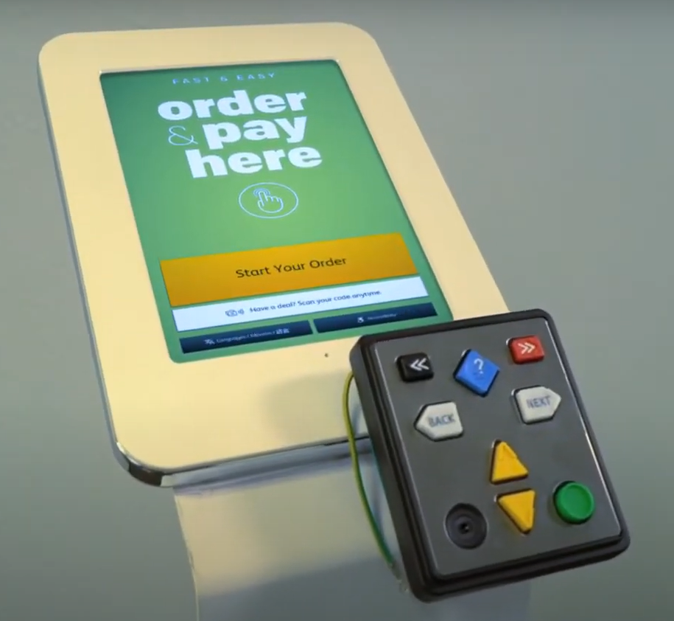

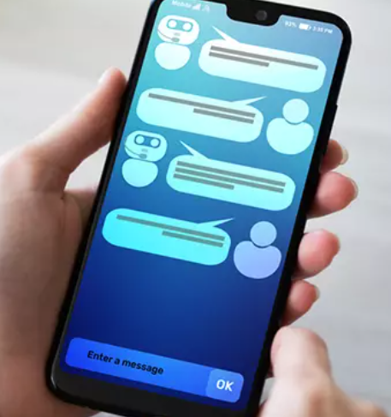
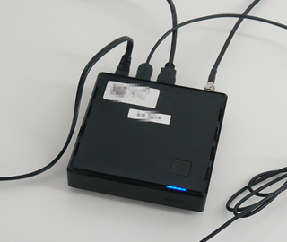
Information and Communication Technology (ICT): everything with an “on” button
Notes:
Today we’re expanding beyond traditional web content. We’ll talk about mobile apps, content creation tools, point-of-sale kiosks, connected TVs, and basically everything with an “on” button. These things are commonly called Information and Communication Technology, or ICT.

Slide 4
Recent examples at TPGi
Smartphone hardware and mobile operating system
Video streaming app
Mainframe terminal applications
A screen sharing app without audio
A training video (non-web)

Slide 5
Other guidelines beyond WCAG can be…
Forgotten
Overwhelming
Puzzling when to apply
Notes:
We’ll also go beyond WCAG. What are these mysterious other guidelines? They’re often forgotten. When people become aware of them they can seem overwhelming at first, and sometimes is puzzling what kinds of situations we need them for, when to apply them.
If you’re coming in unaware, that’s fine, I’ll start by overwhelming you a little bit, then you’ll get some puzzlers, and I hope by the end equip you to solve a few of the puzzles.

Slide 6
Remember!
Notes:
Before we look at some other guidelines, let’s remember what’s most important… It needs to work for people.

Slide 7
What matters: people can use it
Can I physically reach it?
Can I understand its accessibility features?
Does it work with my preferences?
Notes:
Answer questions like these:
Can I get physically close enough to the thing to even press the on button?
Is there help or support so I can understand accessibility features?
Does the thing work with my preferences, like color contrast?

Slide 8
Today’s session is not…
Focused on policy
Everything you need for usability
Notes:
Policy, like whether there’s a legal mandate for a particular part of the world or a particular industry vertical. We could have a whole session figuring out whether they apply to your product in the regions and sectors where you sell it, and this is a moving target.
If you’re looking for minimum compliance, it’s like you’re looking for exciting new opportunities to sell cigarettes to kids. You’re harming people, and the regulatory environment will guarantee you a shrinking market.
That’s why I’m assuming we want to make things accessible, and we’ll follow good precedents wherever they come from.
That said, these precedents are not everything you need for usability. Only users can tell you that.

Slide 9
Guidelines for ICT (Information and Communication Technology)
EN 301 549 (transposed to national laws in Europe)
Section 508 (US)
For regions and sectors: US ACAA (kiosks), US CVAA Performance Objectives, Canada CSA B651.2 (self-service hardware).
Authoring Tool Accessibility Guidelines (ATAG)
Audit guides: RGAA (France), BITV-Test (Germany), Trusted Tester (USA), ACT Rules; BBC; IBM; TPGi audit rules
Built environment guidelines
Notes:
Today I’ll call these guidelines – some are standards or regulations.

Slide 10
Simplifying

Slide 11
Where they all overlap
Functional performance
WCAG 2.x
Notes:
…but specific technical requirements need attention too, and will take up more of this decision tree

Slide 12
Functional performance
EN 301 549 says report them always
CVAA is all about functional performance
Section 508 says report them for “functions not addressed” and “equivalent facilitation”

Slide 13
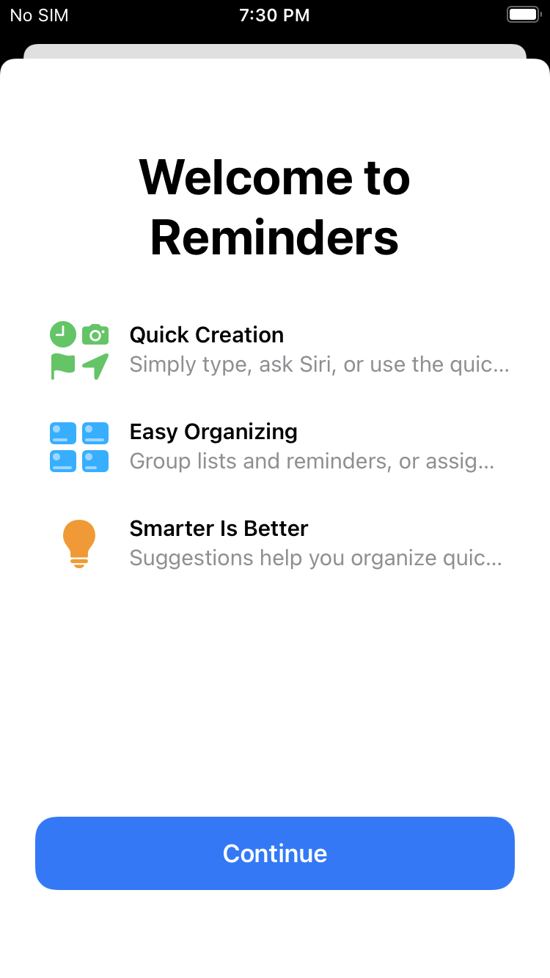
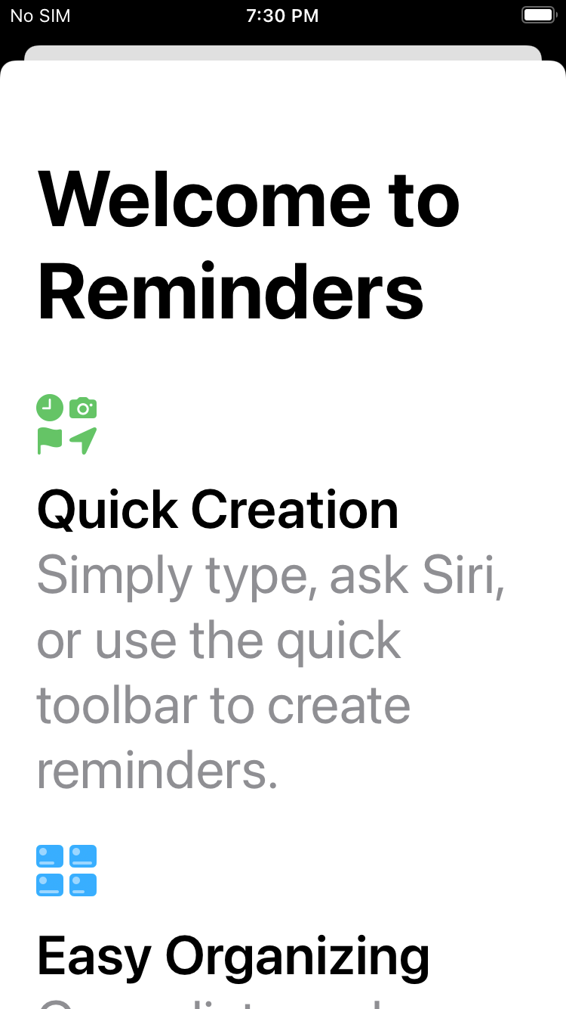
Equivalent Facilitation example
“substantially equivalent or greater accessibility and usability”
Notes:
In an iOS app using Dynamic Type, doubling the size of body text does not double the size of heading text, but maintains relative sizes with less truncation. The heading text does not technically meet WCAG 1.4.4 Resize Text.
But in fact, it provides “substantially equivalent or greater accessibility and usability”

Slide 14
“Stolen” ART
US government requirements for accessible procurement:
https://www.section508.gov/ict-accessibility/
Good examples of ICT with applicable criteria. Example: Smartphone
It doesn’t have:
WCAG 2.1 and other guidelines
Few explanations of 508 applicability beyond the normative language

Slide 15
Did you know…?
Content Creation
Documentation and Support
User Preferences
Isolated, Closed, or Disruptive?
Privacy
Notes:
Now we’re speeding beyond the safe and familiar WCAG. I’ve selected 5 examples of important non-WCAG guidelines to know about. (slide)

Slide 16
Content Creation

Slide 17
More important than all of WCAG: Authoring Tool Prompts
“Authoring tools shall provide a mode of operation that prompts authors to create content that conforms to Level A and Level AA Success Criteria and Conformance Requirements in WCAG 2.0… for supported features and, as applicable, to file formats supported by the authoring tool.” (Section 508)
Why this matters: 43% of the internet is built on one authoring tool: WordPress.
Example of good accessibility prompts: Microsoft Office. Make your content accessible to everyone with the Accessibility Checker - Office 365
Section 508, clause 504 Authoring Tools, 504.3 Prompts Authoring Tool Accessibility Guidelines (ATAG)
Notes:
(slide)
This single criterion is more important than all of WCAG Level A and AA combined…
Later in this presentation I’ll explain “supported features”
(Source: https://WordPress.org “43% of the web uses WordPress” retrieved 2022-03-17)

Slide 18
Authoring tools are more than CMS
“Any software, or collection of software components, that can be used by authors, alone or collaboratively, to create or modify content for use by others”
Examples:
File conversion tool
Modify a web page: website owner controls the content
Modify a web page: user-generated content
Embedded authoring: rich text editor
Notes:
Section 508 definition
Authoring tools are our best chance for accessibility to shift left, for a billion content creators

Slide 19
Documentation and Support
Notes:
When a product has documentation, we have guidelines for the actual content of the online help as well all kinds of support services.

Slide 20
Accessibility help
“Explain how to use the accessibility and compatibility features” in these places:
Product documentation, e.g. online help
Product support channels, e.g. phone, chat
Section 508, Chapter 6 Support Documentation and Services, clauses 602.2 and 603.2 EN 301 549, Chapter 12 Documentation and Support Services, clauses 12.1.1 and 12.2.2
Notes:
Yes, this is a product requirement that might not be inside the digital product itself.

Slide 21
Communication access in support channels
“Accommodate the communication needs of individuals with disabilities” — examples:
Direct TTY
Accept telephone relay services https://www.ada.gov/reachingout/telerelay.html
Alternatives to IVR (Interactive Voice Response)
Answer customer’s questions without relying on vision
Section 508, clause 603.3 Accommodation of Communication Needs EN 301 549, clause 12.2.3 Effective communication Like WCAG 1.3.3 Sensory Characteristics
Notes:
Your help web pages needs to be accessible in the usual ways, but what about support channels like phone? We have guidelines for that too. (slide) You might assume a phone call is inherently accessible for someone who’s blind, but just like on the web, you can’t rely on purely sensory descriptions of the product.
Now what are some of those fabulous accessibility features of your product?

Slide 22
User Preferences

Slide 23
Follow the user’s platform settings
Color (example: night mode)
Contrast
Focus cursor
Font type
Font size (like WCAG 1.4.4 Resize Text, but no resize widget)
Units of measurement (EN 301 549)
Unless “isolated…?”
Section 508, clause 503.2 User Preferences EN 301 549, clause 11.7 User Preferences
Notes:
Start by thinking about smartphones. When the operating system has any of these user settings, apps need to honor them.

Slide 24
Isolated, Closed, or Disruptive?
Notes:
Now we getting into a confusing mess of content that’s isolated, closed, or disruptive

Slide 25

Closed versus Isolated
headphones
install
Closed: kiosk
Open: personal device
App
AT
App
AT
Isolated App
Platform User Preferences
Platform User Preferences
Notes:
What’s the difference between Closed and Isolated?
A device like a kiosk is closed when it does not let the user install or attach their own assistive technology.
They can only plug in headphones and use whatever pre-configured assistive technology is already on the device.
A device like a PC or phone is open when it does let the user install and attach AT.
Suppose this kiosk and this personal device are both running Android, and they both have an app that honors the platform user preferences like contrast. But another app for some reason is sandboxed and can’t access the user preferences — that’s an isolated app.

Slide 26
Is web really “isolated” from the platform?
Web follows browser settings
Web can follow OS settings: contrast, prefers-reduced-motion
Web can send OS events: haptics, notifications
Germany’s BITV-Test expects browser user preferences
Notes:
Is web really “isolated?” (slide)
If this were a talk on conformance reporting I would have to draw a bright line for you here. But we’re not!
So I say a web site should honor browser and underlying operating system preferences, whenever the web page is not in fact isolated from those particular preferences.

Slide 27
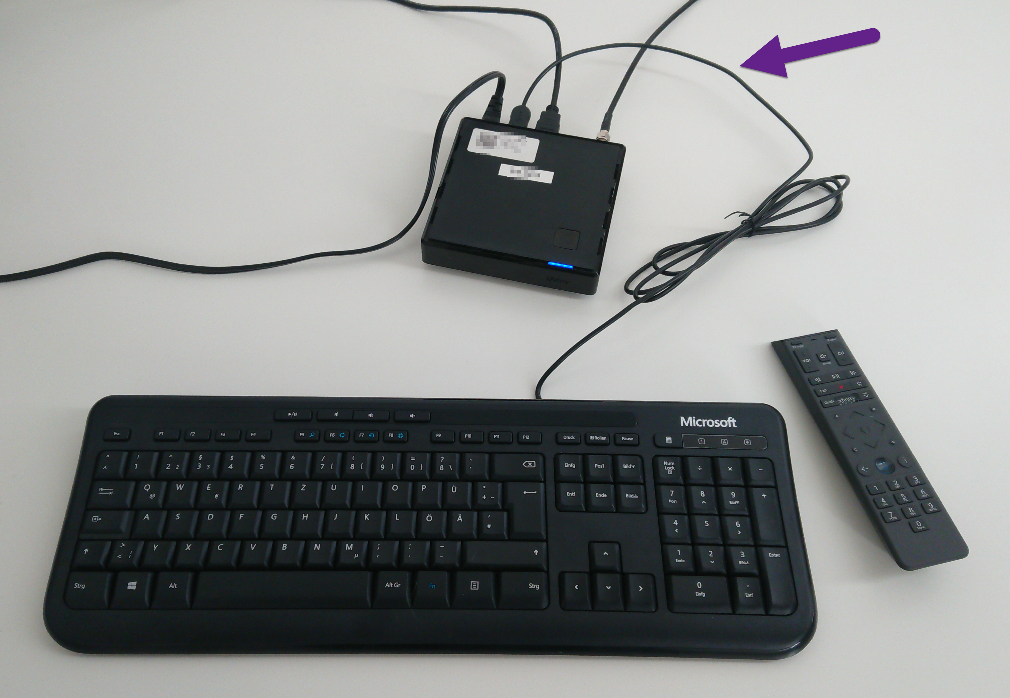
Open or Closed?
Notes:
Here I have a Comcast Xfinity X1 smart TV box. I’ve plugged in a USB keyboard, and the arrow keys on the keyboard work like the TV remote. Is this “open” or “closed” to assistive technology?

Slide 28
Closed functionality
EN 301 549 is more granular:
“Closed to assistive technologies for screen reading” (5.1.3)
“Closed to text enlargement” (5.1.4)
“Closed to keyboards” (5.1.6)
Section 508, clause 402 Closed Functionality (Hardware) EN 301 549, clause 5.1 Closed Functionality
Notes:
When a product has “closed functionality” it means users can’t plug in their own adaptive keyboard, or install their own assistive technology software. This means the product itself needs to provide its own screen reader, among other things.
Software can be closed but not isolated. Example: Locked-down kiosk software. In order to provide nonvisual access, it will either need to integrate with assistive technology (not provided by the user), or “provide an alternative user interface that functions as assistive technology.”

Slide 29
No disruption of accessibility features
Examples of disruption:
Crashing or freezing the screen reader
Suppressing audio
Overriding display scaling (Windows or Mac)
Section 508, clause 502.2.2 No Disruption of Accessibility Features EN 301 549, clause 11.6.2 No Disruption of Accessibility Features
Notes:
Isolation is also sometimes confused with disruption.

Slide 30
Other examples of platform limitations
Examples of platform limitations:
Nested lists are flattened in PDF
No heading levels on mobile apps
A data table in a kiosk with only up and down arrow keys
Unclear how to apply Reflow to a desktop application
Treat as functional performance, and talk to users!
Good news: multiple Voice Control labels for a single iOS control
Notes:
Answer: treat as functional performance. The first three Without Vision; reflow is With Limited Vision.
Ask users if this is something familiar enough on that platform, or if it amounts to a functional problem. “Yeah, yeah” (no big deal) or “yeah no” (I need this a different way).
Also you can find guidance from the platform developer support, like iOS and Android.

Slide 31
Privacy

Slide 32
Privacy: EN Functional Performance
“ICT maintains the privacy of users [of accessibility features] at the same level as other users.”
“Note: Enabling the connection of personal headsets for private listening, not providing a spoken version of characters being masked and enabling user control of legal, financial and personal data are examples of design features that may contribute towards meeting this clause.”
Section 508, chapter 4 Hardware, clause 405 Privacy EN 301 549, 5.1 Closed Functionality, clause 5.1.3.8 Masked entry EN 301 549, 5.1 Closed Functionality, clause 5.1.3.9 Private access to personal data EN 301 549, chapter 4 Functional Performance, clause 4.2.11 Privacy
Notes:
I’m just going to read the Privacy clause of EN 301 549. (slide)
Section 508 only has this for hardware, but most problems like masked characters would likely be covered by WCAG. This is a good example of how knowing guidelines beyond WCAG helps remind us of what’s important.

Slide 33
Putting it all together: an ICT guidelines decision tree
Notes:
You came for a decision tree, but “tree” is kind of a mixed metaphor as you’ll see in a moment.

Slide 34
Is it ICT?
Is it electronic?
Is it hardware?
Is it an application or a document?
Non-web app; hybrid app; web app or web page; part of a web page; document at a URL; non-web document
Does it have documentation or support?
Notes:
These categories map to major guideline clauses that we’re already talked about. (the slide)
When we get to “application or document” it’s too soon to draw bright lines between them, e.g. hybrid app contains web content; a PDF or a video can be a web document or a non-web document. It’s okay not to decide right away. The distinctions are somewhat important for checking the boxes in conformance reporting, usually not so important in how to make them work well for users.
Get ready for disappointment: that’s about the only formal decision tree I’m going to give you…

Slide 35
Application functionality
Real-time communication
Text chat; video chat; real-time voice; telephony
Create or modify content (“authoring tool”)
Software creation tool (“software tool”)
Assistive technology application
Platform software
Browser; operating system
Closed functionality
Notes:
From here it’s more of an inventory of examples.
Next up: we have examples of functionality that might be in your web or non-web application. When they are present, these kinds of functionality make a big difference for accessibility. This is my “greatest hits” list; yours might be different.
(slide)
All of these product functions have specific non-WCAG clauses in the guidelines.

Slide 36
Content types
Static structure: heading, list, data table; informative and decorative images
Interactive structure and navigation: link, button, disclosure, dialog, TV programming rail
User input: form fields; many ARIA patterns; adjustable (iOS); airline seat map; rich content editor; drawing canvas; biometric identification
Video or audio: pre-recorded or live; player controls; recording and editing controls
Accessible alternative content: sign language video; plain language alternative
Multilingual content
Comprises a set of web pages, set of documents, or set of apps
Notes:
Next we take a first cut at major content types. (This is something the US federal ART tool does not do.) Why did I choose this list?
Every web page is going to have semantic elements, but not all authored content does. This is the “supported features” question I mentioned for Authoring Tools. Let’s say you have a tool for creating SVG files of dancing hamsters. Does it need to prompt the hamster author for accessibility decisions?
If you want to make a distinction between a document and an application, a good rule of thumb is if it takes user input then it’s an application.
Finally, some of these content types have specific quality guidelines available for them, like biometric identification or a plain language alternative page.

Slide 37
Hardware functions
Hardware with a user interface: on/off button, control panel, screen
Physical keyboard or keypad
Biometric identification or control
Assistive technology hardware
Hardware that records, processes, transmits, or converts content
Real-time communication: text chat; video chat; voice; telephony
Platform hardware
Closed hardware
Variable message signs
Fixed-location hardware
Notes:
For hardware functionality I’m going into less detail today. I expect fewer people here in the audience will need to drill down typically. So if you want more about hardware, talk to me after. Some examples with specific quality guidelines: (slide)
2017 US federal webinar on hardware: https://www.accessibilityonline.org/cioc-508/session/?id=110614

Slide 38
Documentation and support services
Examples:
Help page
Printed manual
Help desk
Call center
Technical support
Contact form or email
Accessibility statement page
Online chat
Training
Notes:
We already talked about how documentation and support services need to work well for people with disabilities, and explain the accessibility features of the product. Here I’ve concentrated on examples, mainly to remind ourselves of the wide range of possibilities. (slide)

Slide 39
Ambitions for an accessibility decision tree
Correlations among several global guidelines
https://docs.google.com/spreadsheets/d/1MT-a8VxOOMQRAfYgELoRuRH8Rb7VOl-x/edit?usp=sharing&ouid=110053298262061768521&rtpof=true&sd=true

Slide 40
Why, When, and How
Notes:
You came for a decision tree, but “tree” is kind of a mixed metaphor as you’ll see in a moment.

Slide 41
Why is this valuable? Meet user needs!
Empower creators to do the right thing
Apply solutions to established platforms
Apply concepts to emerging platforms
Notes:
Guidelines can help meet user needs — Where there's a published guideline, especially one that’s mandated regardless of jurisdiction, you know a solution exists in established platforms like web, mobile, and hotel elevators.
You can also apply most of these guidelines to emerging platforms, such as extended reality (AR/VR/XR), connected TVs, standalone appliances and connected smart home devices, wearables, and mobility infrastructure from scooters to space elevators.
Encourage product creators to do the right thing – by conforming to standards, both through the more general (functional performance) or through more specific criteria when they’re relevant.

Slide 42
When is this valuable? At every stage
High-level requirements
Technical architecture
Design and development
Testing and auditing
Notes:
When are accessibility guidelines valuable? You need people with disabilities to inform every step, but with reference to long-established solutions. Web and non-web accessibility guidelines have been refined over many years, so you can use them to inform your product development at every stage… I really want everybody to use an accessibility decision tree for high-level requirements and for technical architectures. And of course (rest of the slide)

Slide 43
How to start
Take inventory of what you already have
Provoke questions as you’re designing something new
Derive your own decision tree
Just start!
Notes:
(slide) But whatever you do… just start! It’s a journey

Slide 44

Questions
bit.ly/tpgibeyond

Slide 45
Credits
Hammer image: https://openclipart.org/detail/32161/architetto-martellare

